Slide 1



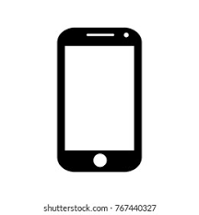




Build Docker Image
CI/CD Pipeline
Git
BTC price code repo
Deploy Docker Image to Prod environment
Monitor application
Alerts

